Slide 1
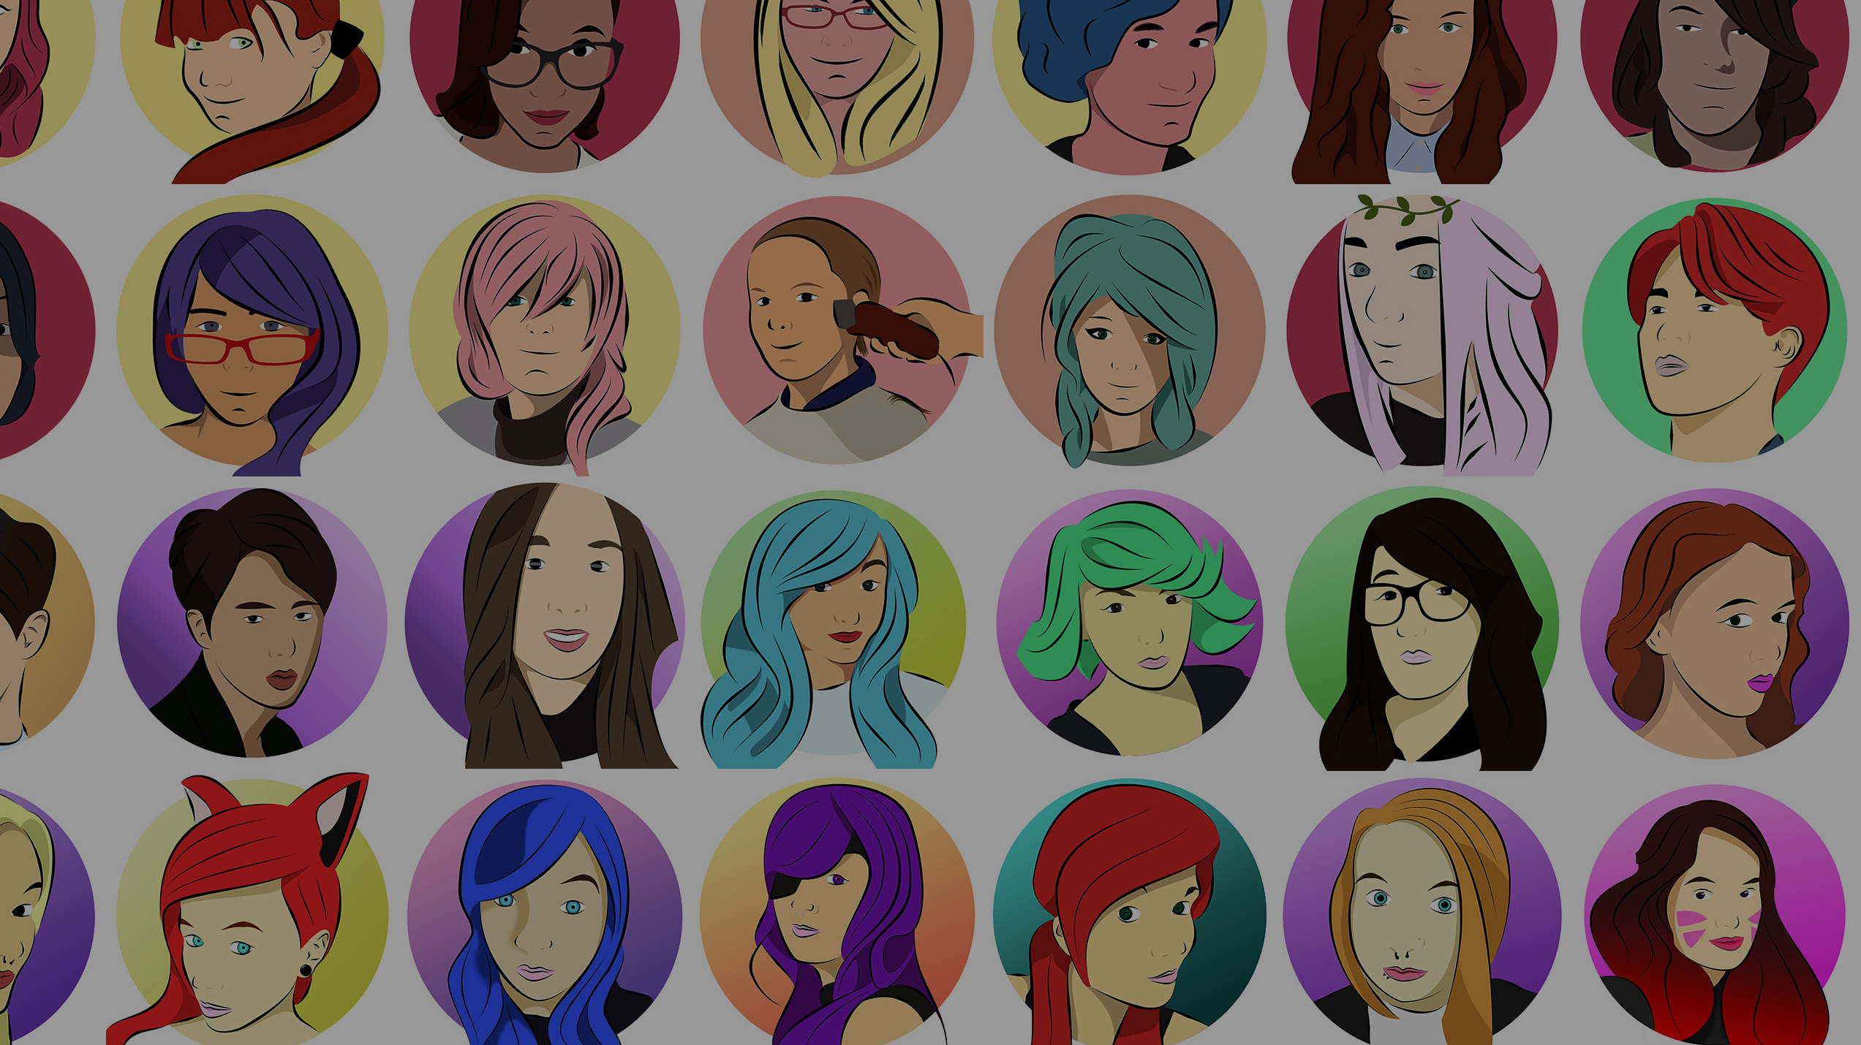
Photoshop Illustrations Tutorial
by Sean O’Mahoney

Slide 2
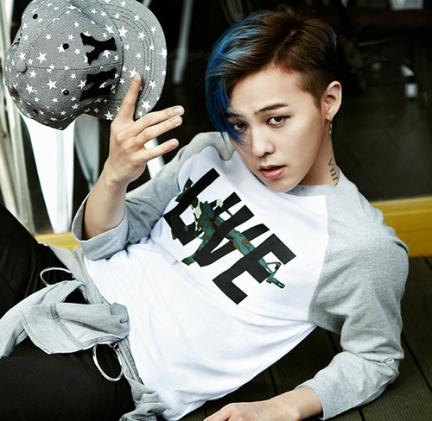
Start with an Image (then to Photoshop)

